Slide 1


Ready, Set, Enroll
Jaime Camargo and Manuel Talavera
Illinois Student Assistance Commission
College Changes Everything Conference
July 21, 2016

Slide 2
Topics
Corps Member Districts
CPS student summary
Myths & Stereotypes
Initiating the conversation
Applying to schools and exploring options
Making the transition
Strategies

Slide 3



Background
Jaime Camargo
Manuel Talavera
Born and raised on Southside of Chicago
Attended Daley Community College
Graduated from Northern Illinois University
Bachelors in Psychology
Born and raised on Southwest of Chicago
Bachelors from Roosevelt University
Masters from University of Illinois-Springfield

Slide 4
District demographics
Wright Community College District
Malcolm X Community College District
Demographics:
12% African American,
76% Latinx
Graduation Rate: 76%
According to Illinois Student Report Card (ISBE 2015) 77% of seniors enroll in college within 12 months
Demographics:
80% African American,
17% Latinx
Graduation Rate: 69%
According to Illinois Student Report Card (ISBE 2015) 48% of seniors enroll in college within 12 months

Slide 5
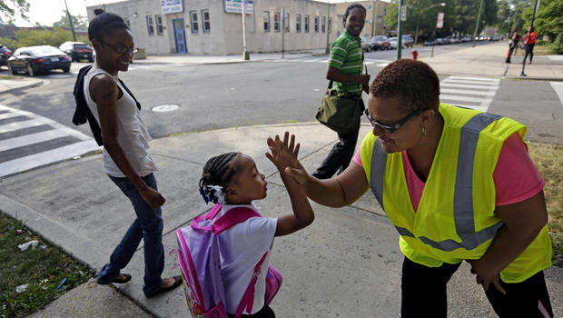

Attending Chicago Public Schools
Transportation
  Safe Passage
Security measures
Not the best faculties
Understaffed
Budget cuts
But overall, they overcome these obstacles

Slide 6


Range of Students
First generation
Future parents
Homeless (20k students)
Incarcerated parents
Students with disabilities
LGBTQ
Undocumented

Slide 7

Myths and stereotypes
Troubled
Future parents should focus on work
Seniors should know it by now
Low performing students should only consider community college
Students/families just don’t care
  Cultural misconceptions

Slide 8

So how do you approach first generation students?

Slide 9
Initiating the conversation
Finding a common ground to speak on
Gather information and assess parental involvement
Coming in with a clear mind
Making ourselves accessible to anyone and everyone
Creating a safe space for communication
Please be patient

Slide 10

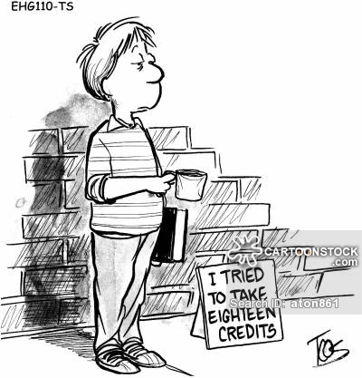
Applying
Explaining the college process → terminology
  Financial Aid (apply early)-work study, award letters, loans
    Verification
    Social Security
Understanding majors/careers
⬜ Understanding their options
Access programs for admitted students
  NEIU Proyecto Pa’lante & NIU Chance
Campus resources, Cultural center, child care
facilities, counseling center, etc….
Frustration with the process

Slide 11


Transitioning to College
Make sure students complete additional steps- Summer Melt
Adjusting to different schedule/ Time management
Mental preparation
Cultural aspects
Best advocate for student? Teach them to fish

Slide 12


Strengths of being a first generation student
Embrace the fact that they are the first
Many advantages of being first
  Trailblazer-Sky's the limit!
  Work hard play hard
  Resilience
Become a leader within their family and community

Slide 13
Strategies
Collect information- Act upon it
Assess scope of parental involvement → Assist parents
Identify high need students (the earlier the better)
Develop a Cohort of first Gen students
Share your experiences
Invite recent alumni
Collaborate with community based organizations
Continuously engage them- students should not feel left out
Utilize ISACorps Services- Find your rep studentportal.isac.org

Slide 14
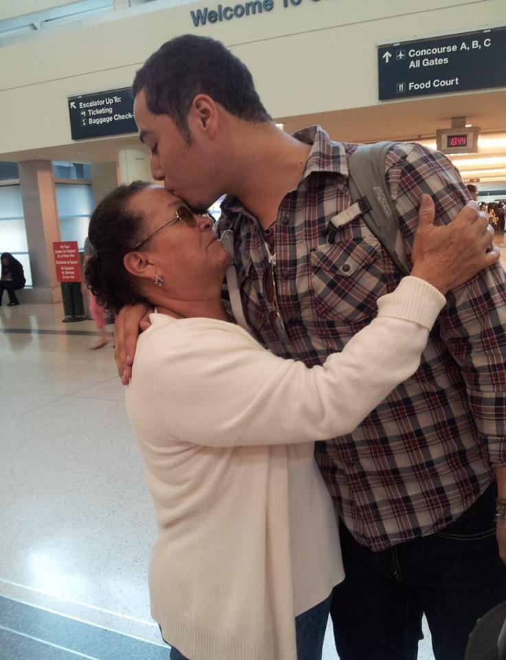
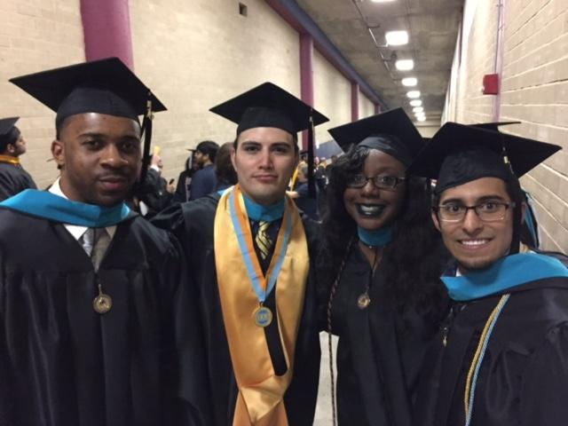
Describing our experiences
How we chose our path
Choosing a Major
Handling Loans
Family involvement
Things we would've done better
How it was the best decision of our life

Slide 15
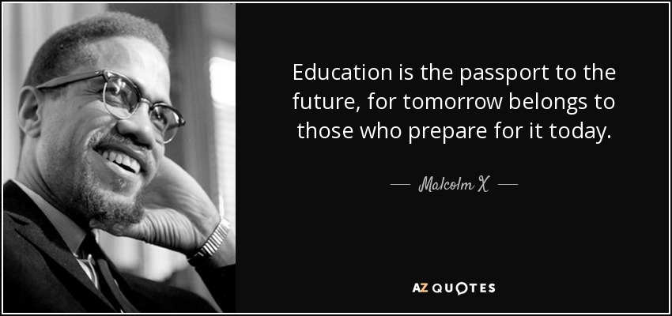
Contact info
Jaime Camargo
(773) 387- 0753
Jaime.camargo@isac.illinois.gov
Manuel Talavera
(312) 590-7527
manuel.talavera@isac.illinois.gov

